Slide 1
Athletic Department
Integrity Honor Excellence
WELCOME TO CHRISTIAN BROTHERS!
New Parent Athletic Orientation

Slide 2
New Parent Athletic Orientation 2020– 2021
Athletic Department Staff and Contact Information
Dale Milton- Athletic Director 916-733-3672 dmilton@cbhs-sacramento.org
Melissa Flowers- Assistant Athletic Director 916-733-3683 mflowers@cbhs-sacramento.org
Gloria Barela – Athletic Admin. Assist. 916-733-3610 gbarela@cbhs-sacramento.org

Slide 3
CB Athletics “Why” Goals Vs Purpose -Integrity -Honor -Excellence Success is peace of mind attained only through self-satisfaction in knowing you made the effort to become the best you are capable. John Wooden 1934

Slide 4
Lasallian Five Core Principles
Faith in the Presence of God. Belief in the living presence of God in our world. ...
Respect for All Persons. A concerted effort by the school to respect the dignity of all persons.
Inclusive Community. ...
Concern for the Poor and Social Justice. ...
Quality Education.
The Patron Saint of Teachers
Saint John Baptist de La Salle

Slide 5
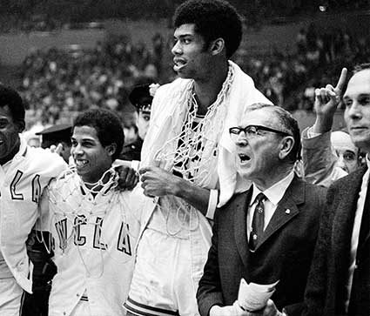
Seven Point Creed
John Wooden was incredibly influenced by his father, Joshua Wooden.
A timeless gift that his father gave him as a teenager was entitled “Seven Things to Do” – which Coach later coined as his famous “Seven Point Creed.”
Be true to yourself.
Help others.
Make each day your masterpiece.
Drink deeply from good books, especially the Bible.
Make friendship a fine art.
Build a shelter against a rainy day.
Pray for guidance and give thanks for your blessings every day.

Slide 6
Enrollment
Upload physical that will last entire season of sport.
If multiple sports (e.g. football and baseball, physical that lasts through May).
Any questions see Gloria Barela in the Athletic Department. 916 733-3610 gbarela@cbhs-sacramento.org

Slide 7
COVID 19 Changes
• Please note the following important information concerning the upcoming athletic year: The California Interscholastic Federation (CIF) and CIF Sac-Joaquin Section announced modified dates for this year’s competitive sports seasons. The changes, necessitated by public health restrictions related to the COVID-19 pandemic, include moving the start of athletics to late December and reducing the standard three seasons (Fall, Winter, and Spring) to two (Season 1 and Season 2). The seasons will begin in late December 2020 and run through June 2021.

Slide 8
Season One (Begins 12/7/20):
Football
Cheer
Cross Country
Volleyball (Men’s and Women’s)
Water Polo (Men’s and Women’s)

Slide 9
Season Two (Begins 2/22/21):
Soccer (Men’s and Women’s)
Tennis (Men’s and Women’s)
Basketball (Men’s and Women’s)
Baseball
Softball
Golf (Men’s and Women’s)
Swim and Dive (Men’s and Women’s)
Track and Field
Lacrosse (Men’s and Women’s)

Slide 10
PAPERWORK + POLICY MANAGEMENT
-Physicals
-Review and distribute special state and county requirements.
STAFF MANAGEMENT
- Mobile Health Screening Tools
-Provide staff with a mobile tool to:
a) Take attendance b) Screen athletes c) Create reports
-Virtual Coach and Team Meetings
-Review national, state, and local guidance to enhance safety.
-Coach Education COVID 19 Training online certification.
SPORTS EQUIPMENT MANAGEMENT
-Equipment Reconditioning
- Confirm that your reconditioning resources are up and running.
- HEALTH & SAFETY EQUIPMENT MANAGEMENT
-Tape or paint for marking safe spaces
-Hand sanitizer, sanitizing wipes, and face masks
COMMUNICATION
-TeamSnap
-Microsoft Teams
-Final Forms
Communication through a coach’s personal cell phone to an athlete is prohibited

Slide 11
Facts for you and your child to consider when deciding whether to participate in CB athletics:
The administration encourages all students to tryout for athletic teams and supports the multi-sport option.
High school athletics can be more competitive and requires more time than what your son or daughter is used to.
Choosing to be a student-athlete means you and your family will have more time constraints than other students.
Academics
Vacations – Summer, Thanksgiving, Christmas, Easter (check early with the coach) Holiday Tournaments
Flexible practice schedule as well as offsite practices as well

Slide 12
What is expected of you as parents:
To represent and support CB Athletics in a Lasallian manner.
Support all coaches, players and officials as well as visiting teams.
You are expected to let the coaches coach their respective teams in the manner they see appropriate. Questions or concerns should be directed to the coach at the appropriate time. (24 hour rule)
Please do not disrupt a coach during practice, games, or meeting times. This is their classroom which needs to be respected.
Practice and game times will be listed on the website under each sport heading, but communicate with your child about last minute practice and game changes.

Slide 13
What should your child expect:
1.To be coached in a Lasallian manner.
2. That all sports are considered important by the administration of Christian Brothers High School.
3. To have a fair opportunity to make an athletic team.
4. To be guaranteed practice time, not game time.
5. To have a wide variety of sports to choose from.

Slide 14
Things to consider:
Don’t compare your child’s abilities with others.
Please follow the appropriate procedures when you have questions or concerns.
Acknowledge the commitment the coaches are making to the athletes.
What must each student have to participate on a team?
An Athletic file completed and turned into Final Forms. Students are not allowed to condition, tryout or participate without current completed forms on file.
CIF Standards – minimum of 2.0 G.P.A. at each quarter’s grading period. Students who fall below must wait until the next grading period to become eligible again.
Athletic Department Standards – minimum 2.0 G.P.A. during season of participation. Grades will be checked periodically and students falling below minimum standards will:
Be temporarily suspended from practice and games until minimum standards are met.
Attend mandatory study hall Monday – Thursday (school days) from 3:15 – 4:30

Slide 15
Transportation:
1.Transportation will not be provided:
Varsity contests within greater Sacramento area
All contests beginning after 6:00pm
Weekend and non-school days
2. When buses are used they will be drop only and parents will be expected to plan for transporting their children home.
*COVID 19 could change the travel policy*

Slide 16
Other Information:
Participation in sports outside of Christian Brothers – the head coach will determine the policy for allowing student-athletes to compete on a different non-school sports team during their high school season. High school athletics takes priority over all outside participation.
There is a non-refundable athletic fee ($110) for each participant during each season of sport.
The Student-Parent Athletic Handbook is part of the School Handbook that each family will receive at the beginning of the school year. Please read the entire handbook carefully. Also found under info and forms on the CB Athletics Website.
A student-athlete who quits a sport or is dropped from one sport for disciplinary reasons will not be permitted to participate in a second sport until the first sport ends.
Christian Brothers competes in the Capital Athletic League, a Division 3 League against. El Camino, Vista De Lago and Rio Americano, Del Campo, Sacramento High and Capital Christian.

Slide 17
Wayne Bryan Raising Your Child To BE A Champion in Athletics, Arts, And Academics

Slide 18
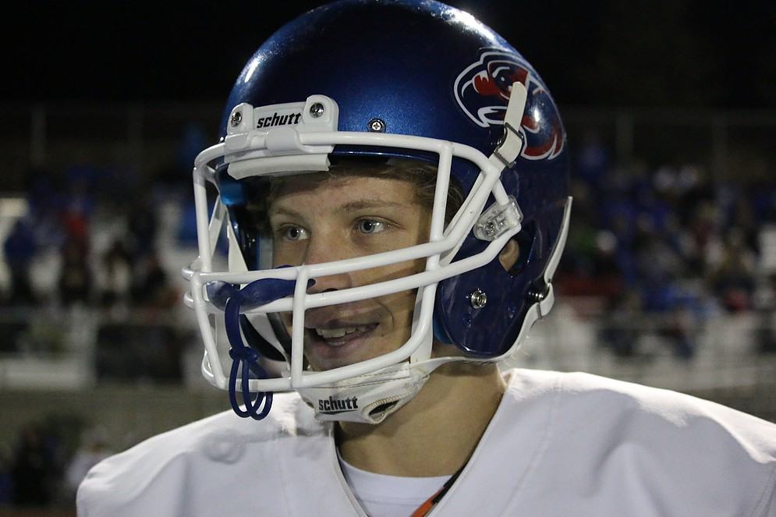
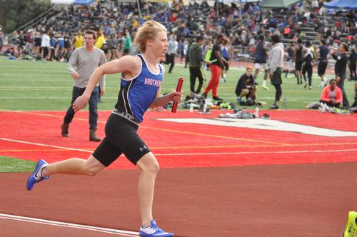
Wayne Bryan Raising Your Child To BE A Champion in Athletics, Arts, And Academics
Two Great Chapters:
A Secondary Passion and Tough Times

Slide 19
Role of Parents?
Before the season - understand why they play
During a contest – be a positive role model
After a contest – give them time
Three Questions- After a contest-
Gatorade or water? If over 16 do you want to drive or me? What would you like to Eat?

Slide 20
Why is your son/daughter playing the sport?
Do you know why he/she is playing high school sports?
Whose choice is it to play?
30 Million High School Athletes; 1% play in College at Div I, II, III. Is she/he playing for the right reasons? Enjoying the experience?

Slide 21
The Parents’ Playbook
THE PARENTS’ PLAYBOOK
Empowering Messages for Parents

